Slide 1

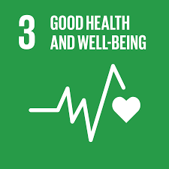
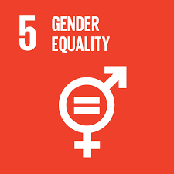


NLIS project
Impact of the project
The Challenge
Raichur experiences drought once in 4 years and faces challenges in providing the local population with access to clean drinking water
The region is water stressed with
Annual rainfall of only 502 mm
24% of the rural population has access to tapped treated water
Water has attributes of excess fluoride, nitrates, and iron
Mission
Delivering safe and affordable drinking water and improve living conditions
Who
The project will benefit all the rural population in Raichur district
Contribution
Financing and construction of WTP
Impact and ESG lens – Measuring SDG impacts and monitoring HSE and social risks associated with the project
Input
Activities
Outputs
Outcomes
Long Term
Impact
What
Supervising and monitoring construction of:
WTP (Water treatment plant) of 160 MLD capacity and rehabilitating old WTPs
Improved access to safe and affordable drinking water
Augmentation of water treatment capacity
Increased water efficiencies in water delivery
Increase in # of households that will be serviced by tapped treated water
Improved sustainability of municipal water practices
Improved health & reduction of incidences of waterborne diseases
Gender Equity
Creating skilled and semi-skilled jobs
Improved climate resiliency through access to safe and affordable drinking water
Increased equality & women participation in economic activities
Increase in household savings by reduction in expenditure on water borne diseases and days lost
6
CLEAN WATER AND SANITATION
3
Risks
External risk – The project delivers water till OHT level from there household connections will be built under another govt. project. The quality of that infrastructure, risk of leakage and contaminations. Although our project will have chlorine dosing to factor in these risks.
Endurance – It is important for us to deliver reliable, enduring and long-term impact; Our contract have long term maintenance contracts and requires training of client

